Slide 1
Notes:
\

Slide 2



Slide 4
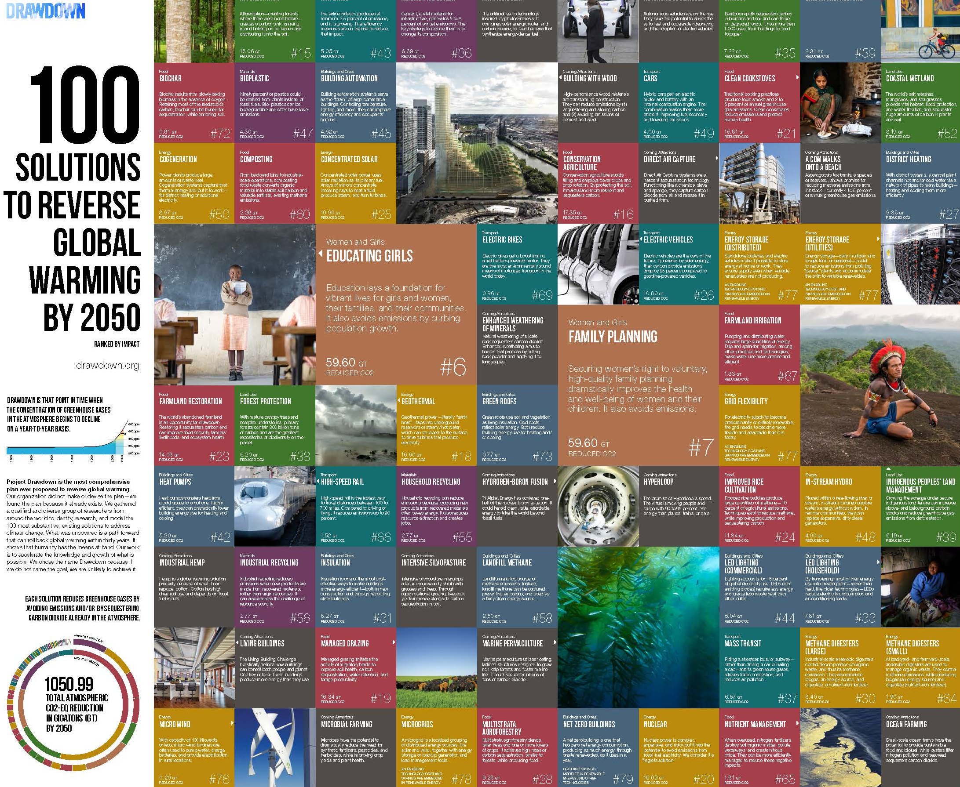

Slide 6
REPLACE
REDUCE
BIOSEQUESTER

Slide 7
RANK SOLUTION SECTOR REDUCED CO2
TOP 20
1 Refrigeration Materials 89.74 GT
2 Wind Turbines (Onshore) Energy 84.60 GT
3 Reduced Food Waste Food 70.53 GT
4 Plant-Rich Diet Food 66.11 GT
5 Tropical Forests Land Use 61.23 GT
6 Educating Girls Women and Girls 59.60 GT
7 Family Planning Women and Girls 59.60 GT
8 Solar Farms Energy 36.90 GT
9 Silvopasture Food 31.19 GT
10 Rooftop Solar Energy 24.60 GT
11 Regenerative Agriculture Food 23.15 GT
12 Temperate Forest Land Use 22.61 GT
13 Peatlands Land Use 21.57 GT
14 Tropical Staple Tree Crops Food 20.19 GT
15 Afforestation Land Use 18.06 GT
16 Conservation Agriculture Food 17.35 GT
17 Tree Intercropping Food 17.20 GT
18 Geothermal Energy 16.60 GT
19 Managed Grazing Food 16.34 GT
20 Nuclear Energy 16.09 GT

Slide 8
RANK SOLUTION SECTOR REDUCED CO2
TOP 20
1 Refrigerant Management Materials 89.74 GT
2 Wind Turbines (Onshore) Energy 84.60 GT
3 Reduced Food Waste Food 70.53 GT
4 Plant-Rich Diet Food 66.11 GT
5 Tropical Forests Land Use 61.23 GT
6 Educating Girls Women and Girls 59.60 GT
7 Family Planning Women and Girls 59.60 GT
8 Solar Farms Energy 36.90 GT
9 Silvopasture Food 31.19 GT
10 Rooftop Solar Energy 24.60 GT
11 Regenerative Agriculture Food 23.15 GT
12 Temperate Forest Land Use 22.61 GT
13 Peatlands Land Use 21.57 GT
14 Tropical Staple Tree Crops Food 20.19 GT
15 Afforestation Land Use 18.06 GT
16 Conservation Agriculture Food 17.35 GT
17 Tree Intercropping Food 17.20 GT
18 Geothermal Energy 16.60 GT
19 Managed Grazing Food 16.34 GT
20 Nuclear Energy 16.09 GT
Electricity
is only
5 of top 20

Slide 9
RANK SOLUTION SECTOR REDUCED CO2
TOP 20
1 Refrigerant Management Materials 89.74 GT
2 Wind Turbines (Onshore) Energy 84.60 GT
3 Reduced Food Waste Food 70.53 GT
4 Plant-Rich Diet Food 66.11 GT
5 Tropical Forests Land Use 61.23 GT
6 Educating Girls Women and Girls 59.60 GT
7 Family Planning Women and Girls 59.60 GT
8 Solar Farms Energy 36.90 GT
9 Silvopasture Food 31.19 GT
10 Rooftop Solar Energy 24.60 GT
11 Regenerative Agriculture Food 23.15 GT
12 Temperate Forest Land Use 22.61 GT
13 Peatlands Land Use 21.57 GT
14 Tropical Staple Tree Crops Food 20.19 GT
15 Afforestation Land Use 18.06 GT
16 Conservation Agriculture Food 17.35 GT
17 Tree Intercropping Food 17.20 GT
18 Geothermal Energy 16.60 GT
19 Managed Grazing Food 16.34 GT
20 Nuclear Energy 16.09 GT
Food system is 8 of top 20

Slide 10
RANK SOLUTION SECTOR REDUCED CO2
TOP 20
1 Refrigeration Materials 89.74 GT
2 Wind Turbines (Onshore) Energy 84.60 GT
3 Reduced Food Waste Food 70.53 GT
4 Plant-Rich Diet Food 66.11 GT
5 Tropical Forests Land Use 61.23 GT
6 Educating Girls Women and Girls 59.60 GT
7 Family Planning Women and Girls 59.60 GT
8 Solar Farms Energy 36.90 GT
9 Silvopasture Food 31.19 GT
10 Rooftop Solar Energy 24.60 GT
11 Regenerative Agriculture Food 23.15 GT
12 Temperate Forest Land Use 22.61 GT
13 Peatlands Land Use 21.57 GT
14 Tropical Staple Tree Crops Food 20.19 GT
15 Afforestation Land Use 18.06 GT
16 Conservation Agriculture Food 17.35 GT
17 Tree Intercropping Food 17.20 GT
18 Geothermal Energy 16.60 GT
19 Managed Grazing Food 16.34 GT
20 Nuclear Energy 16.09 GT
Land Management is 4 of top 20

Slide 11
RANK SOLUTION SECTOR REDUCED CO2
TOP 20
1 Refrigeration Materials 89.74 GT
2 Wind Turbines (Onshore) Energy 84.60 GT
3 Reduced Food Waste Food 70.53 GT
4 Plant-Rich Diet Food 66.11 GT
5 Tropical Forests Land Use 61.23 GT
6 Educating Girls Women and Girls 59.60 GT
7 Family Planning Women and Girls 59.60 GT
8 Solar Farms Energy 36.90 GT
9 Silvopasture Food 31.19 GT
10 Rooftop Solar Energy 24.60 GT
11 Regenerative Agriculture Food 23.15 GT
12 Temperate Forest Land Use 22.61 GT
13 Peatlands Land Use 21.57 GT
14 Tropical Staple Tree Crops Food 20.19 GT
15 Afforestation Land Use 18.06 GT
16 Conservation Agriculture Food 17.35 GT
17 Tree Intercropping Food 17.20 GT
18 Geothermal Energy 16.60 GT
19 Managed Grazing Food 16.34 GT
20 Nuclear Energy 16.09 GT
Land + Food
is 12 of top 20

Slide 12
RANK SOLUTION SECTOR REDUCED CO2
TOP 20
1 Refrigeration Materials 89.74 GT
2 Wind Turbines (Onshore) Energy 84.60 GT
3 Reduced Food Waste Food 70.53 GT
4 Plant-Rich Diet Food 66.11 GT
5 Tropical Forests Land Use 61.23 GT
6 Educating Girls Women and Girls 59.60 GT
7 Family Planning Women and Girls 59.60 GT
8 Solar Farms Energy 36.90 GT
9 Silvopasture Food 31.19 GT
10 Rooftop Solar Energy 24.60 GT
11 Regenerative Agriculture Food 23.15 GT
12 Temperate Forest Land Use 22.61 GT
13 Peatlands Land Use 21.57 GT
14 Tropical Staple Tree Crops Food 20.19 GT
15 Afforestation Land Use 18.06 GT
16 Conservation Agriculture Food 17.35 GT
17 Tree Intercropping Food 17.20 GT
18 Geothermal Energy 16.60 GT
19 Managed Grazing Food 16.34 GT
20 Nuclear Energy 16.09 GT
Refrigeration is the top solution

Slide 13
RANK SOLUTION SECTOR REDUCED CO2
TOP 20
1 Refrigeration Materials 89.74 GT
2 Wind Turbines (Onshore) Energy 84.60 GT
3 Reduced Food Waste Food 70.53 GT
4 Plant-Rich Diet Food 66.11 GT
5 Tropical Forests Land Use 61.23 GT
6 Educating Girls Women and Girls 59.60 GT
7 Family Planning Women and Girls 59.60 GT
8 Solar Farms Energy 36.90 GT
9 Silvopasture Food 31.19 GT
10 Rooftop Solar Energy 24.60 GT
11 Regenerative Agriculture Food 23.15 GT
12 Temperate Forest Land Use 22.61 GT
13 Peatlands Land Use 21.57 GT
14 Tropical Staple Tree Crops Food 20.19 GT
15 Afforestation Land Use 18.06 GT
16 Conservation Agriculture Food 17.35 GT
17 Tree Intercropping Food 17.20 GT
18 Geothermal Energy 16.60 GT
19 Managed Grazing Food 16.34 GT
20 Nuclear Energy 16.09 GT

Slide 14
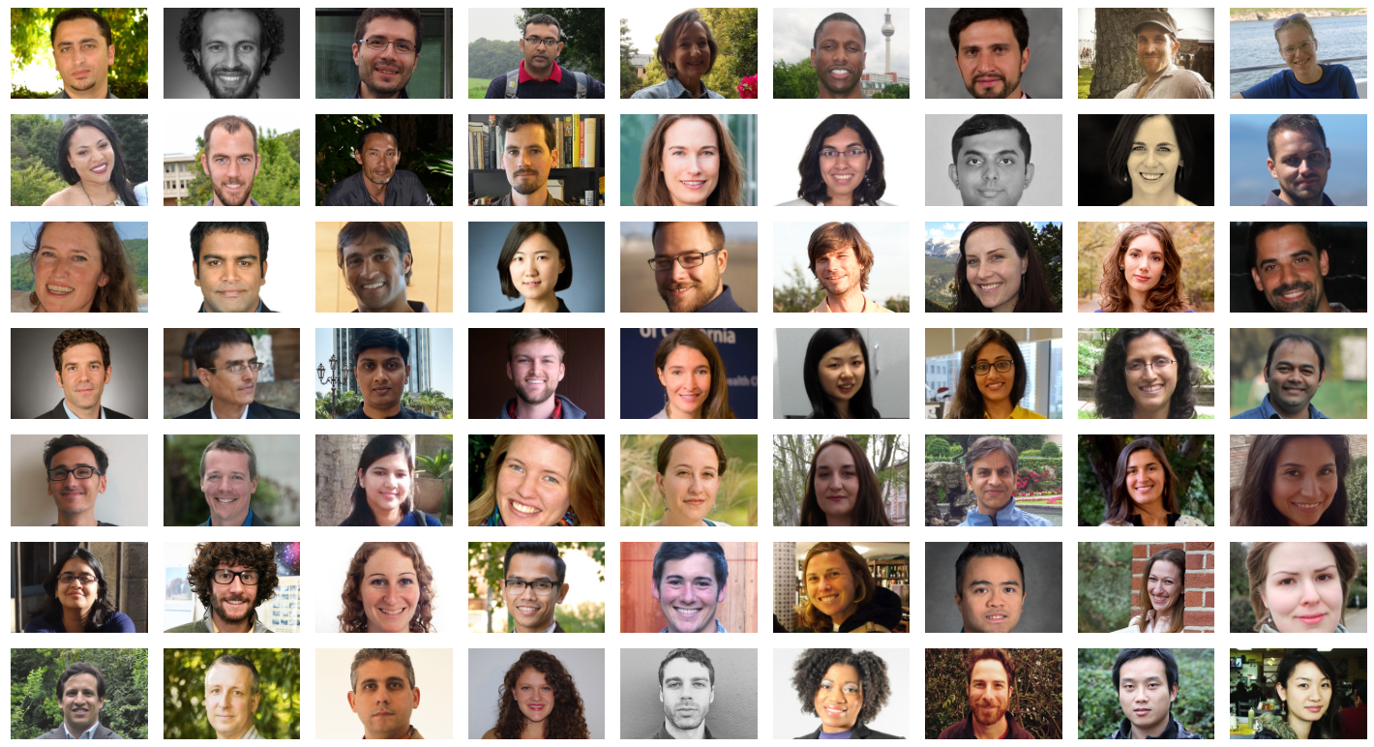

Slide 16
The Results
Emissions Reduction (and Sequestration for Land Solutions)
Net First Cost
Net Operating Cost or Savings
Payback Periods
Abatement Costs
Other Specialized Outputs

Slide 17
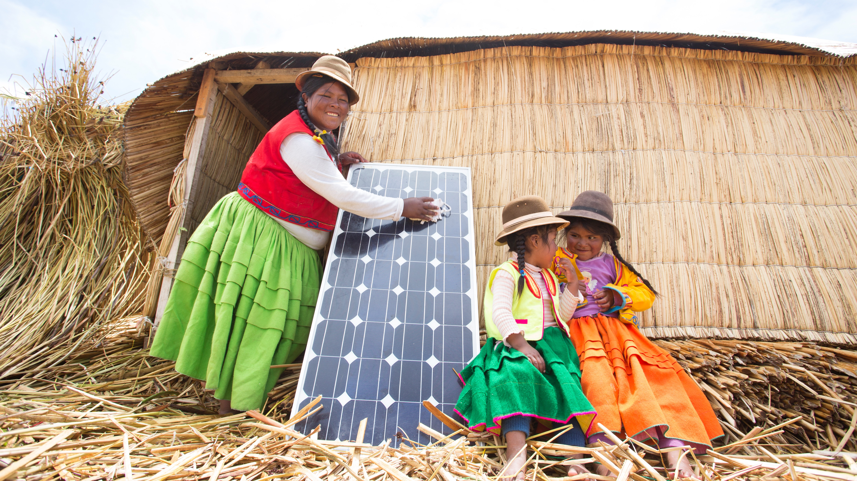
ROOFTOP
SOLAR
#10
24.6 GT
RANK BY 2050
REDUCED CO2 -eq
$453B
$3.46T
NET FIRST COST
NET OPERATIONAL SAVINGS

Slide 18

TROPICAL
FORESTS
#5
61.23 GT
RANK BY 2050
REDUCED CO2 -eq
Credit: Mike Lanzetta

Slide 19
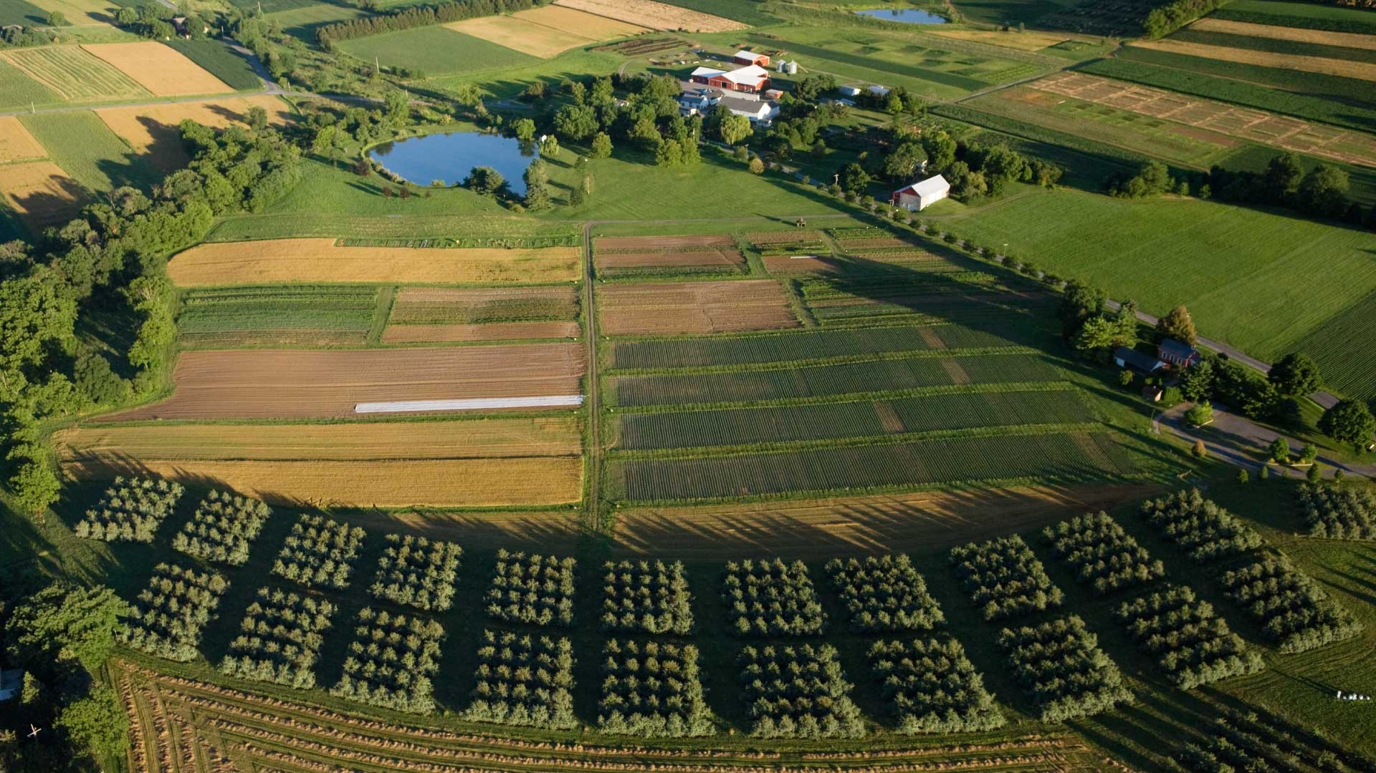
REGENERATIVE
AGRICULTURE
#11
23.15 GT
RANK BY 2050
REDUCED CO2 -eq
$57.2B
$1.93T
NET FIRST COST
NET OPERATIONAL SAVINGS

Slide 20

PLANT-RICH
DIET
#4
66.11 GT
RANK BY 2050
REDUCED CO2 -eq
Credit: Imagno
Notes:
has a massive impact on global warming.
A plant-rich diet is not about being vegetarian or vegan, but about eating a healthy diet – in terms of how much we consume overall, and particularly how much meat is consumed. The richer parts of the world overconsume while low-income countries show insufficient caloric and protein intake. That needs rebalancing.
Moreover, approximately one-third of all food produced in the world (SLIDE FOOD WASTE)

Slide 21
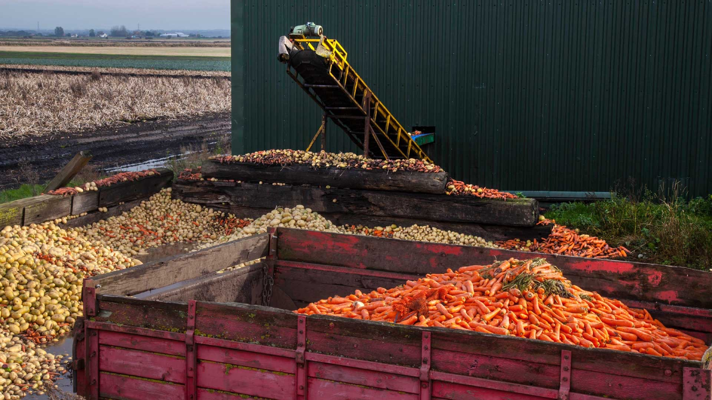
REDUCED
FOOD WASTE
#3
70.53 GT
RANK BY 2050
REDUCED CO2 -eq
Credit: EnVogue_Photo / Alamy Stock Photo

Slide 22

FAMILY PLANNING
#7
59.60 GT
RANK BY 2050
REDUCED CO2 -eq
Credit: Said Khatib

Slide 23
RANK SOLUTION SECTOR REDUCED CO2
TOP 20
1 Refrigerant Management Materials 89.74 GT
2 Wind Turbines (Onshore) Electricity 84.60 GT
3 Reduced Food Waste Food 70.53 GT
4 Plant-Rich Diet Food 66.11 GT
5 Tropical Forests Land Use 61.23 GT
6 Educating Girls Women and Girls 59.60 GT
7 Family Planning Women and Girls 59.60 GT
8 Solar Farms Electricity 36.90 GT
9 Silvopasture Food 31.19 GT
10 Rooftop Solar Electricity 24.60 GT
11 Regenerative Agriculture Food 23.15 GT
12 Temperate Forest Land Use 22.61 GT
13 Peatlands Land Use 21.57 GT
14 Tropical Staple Tree Crops Food 20.19 GT
15 Afforestation Land Use 18.06 GT
16 Conservation Agriculture Food 17.35 GT
17 Tree Intercropping Food 17.20 GT
18 Geothermal Electricity 16.60 GT
19 Managed Grazing Food 16.34 GT
20 Nuclear Electricity 16.09 GT
Women & girls: when combined, it is top solution.

Slide 25
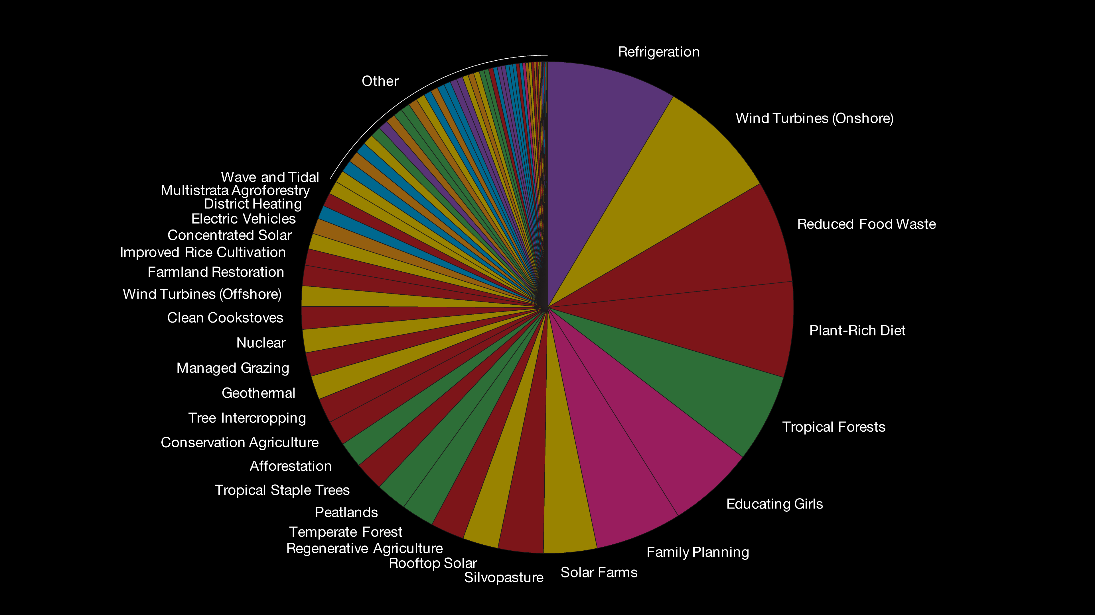
Drawdown

Slide 26
Collaboration:
breaking down silos

Slide 28
COST
29 trillion US$ over 30 years
SAVINGS
74 trillion US$ over 30 years

Slide 29


Slide 30
@ProjectDrawdown
@ChadFrischmann

